Slide 1
Torque on a Current Loop in Magnetic Field
Presented by: Sunaina Motwani, Jotika Hablani, Nency Sonzai

Slide 2
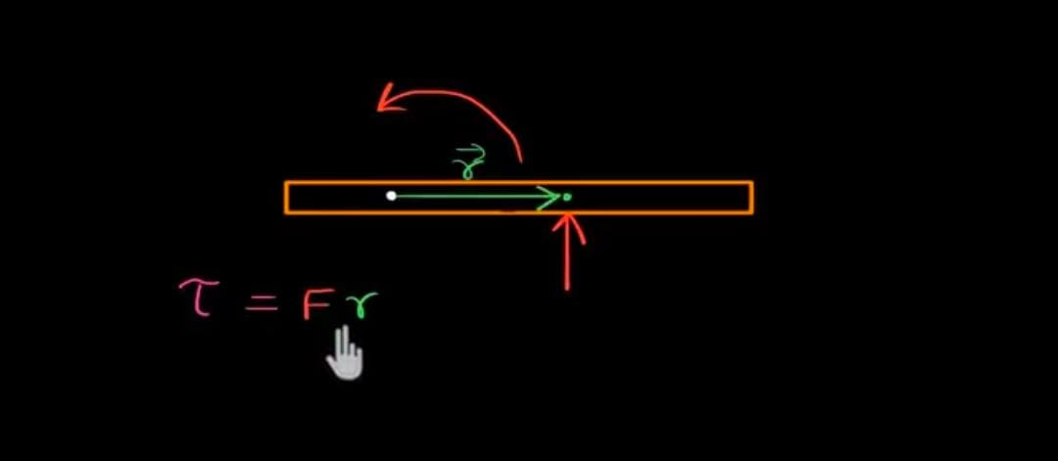
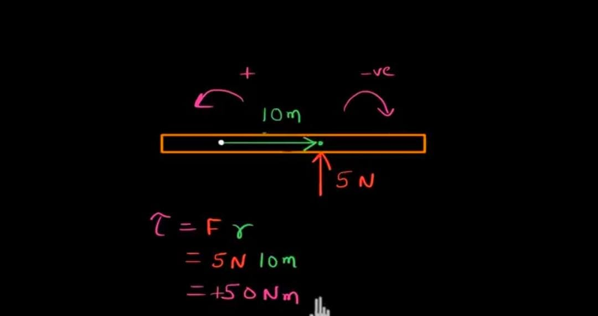
✅ What is Torque?
Torque is the force that causes rotation. Like opening a door .
Right-Hand Rule: - In torque on a current loop, the right-hand rule helps you find:
-Which way the loop will rotate.
-Direction of torque vector
Formula: τ = F × r
τ = Torque
F = Force
r = Perpendicular distance
Unit: Newton-meter (Nm)

Slide 3
🔁 What is a Current Loop?
A wire shaped in a loop with electric current. It behaves like a tiny magnet.
Easy line: A circle of wire where electricity flows and creates a magnetic effect.

Slide 4
What is Magnetic Field?
An area around a magnet where magnetic forces can b felt.
The invisible area where magnets can pull or push things.
If a current-carrying wire is placed in a magnetic field, it experiences a force.
Now the Main Part: What Happens When You Put a Current Loop in a Magnetic Field?
When the loop is placed in a magnetic field, each side of the loop feels a “magnetic force”. These forces do not cancel out— instead, they create a TORQUE. This torque *tries to rotate the loop*.

Slide 5
Direction & Maximum Torque
Maximum Torque: When angle = 90° , because sin(90°) = 1.
Minimum Torque: When angle = 0° or 180°, because sin(0° or 180°) = 0.
Torque is strongest when the loop is perpendicular to the magnetic field.

Slide 6
🔄 Torque on a Current Loop in Magnetic Field
Magnetic field pushes on the current loop, making it rotate. This rotation is called torque.
Easy line: Magnetic field makes the loop spin like a motor!

Slide 7
🧮 Formula for Torque on Current Loop
Formula: τ = IAB sinθ
I = Current (Amps)
A = Area of loop (m²)
B = Magnetic Field (Tesla)
θ = Angle between loop and magnetic field
Easy line: More current, bigger loop, or stronger field = more spin!

